Slide 1
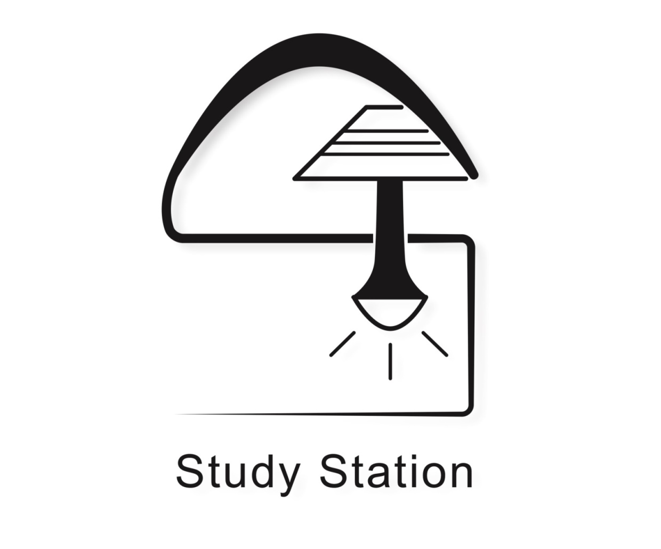
Ambient Intelligence 2016
Borraccini Giacomo
Gabriele Ciravegna
Fabio Cofano
Andrea Coluccio
http://ami-2016.github.io/StSt/

Slide 2

Our Vision
In our society we necessarily spend a lot of time sitting (working, studying, etc.)
This habit may cause many health issues.
People who wants to correct or avoid those issues will be interested in our system

Slide 3
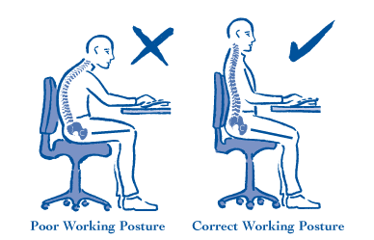
The goal
“Study Station“ helps you maintaining a correct posture.
It also lets you regulate the room brightness
It will notify you whether you’re sitting in the right way with a correct room brightness or not.

Slide 4
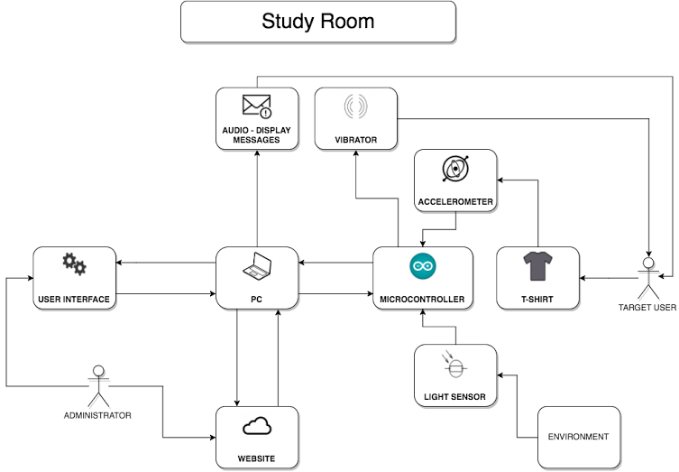
Top view

Slide 5
Hardware Architecture
Computational nodes: PC, Microcontroller
Sensors: Accelerometers, Light Sensor
Actuator: Vibrator
User interface device: PC

Slide 6
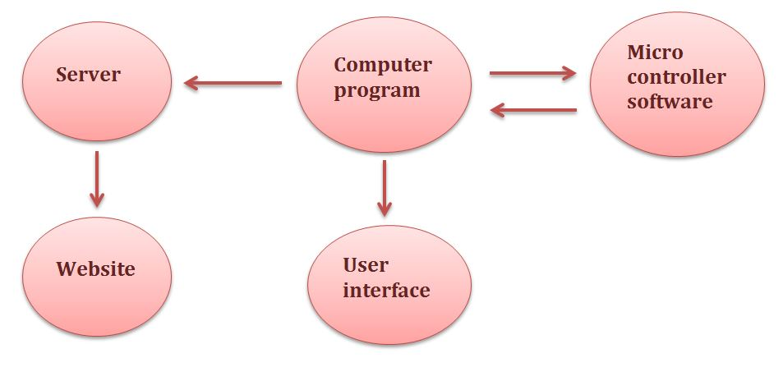
Software Architecture

Slide 7
Thank you for your attention

